Slide 1
NEST360 Implementation Model
Kylie Dougherty
Nairobi, 2025
Notes:
Funders (Maria, Aba, Nahya, Esalee)
Leadership (Cate, George, Mariam)
End-users (at the hospital level) (Danica, Natasha, Cathy-MW)
Can we create a working group for this with all the audiences q 2 weeks
Better to quickly write to particular audiences
Can work fasters/smarter to get all the information
Do you suggest anyone else? TAT in each level

Slide 2
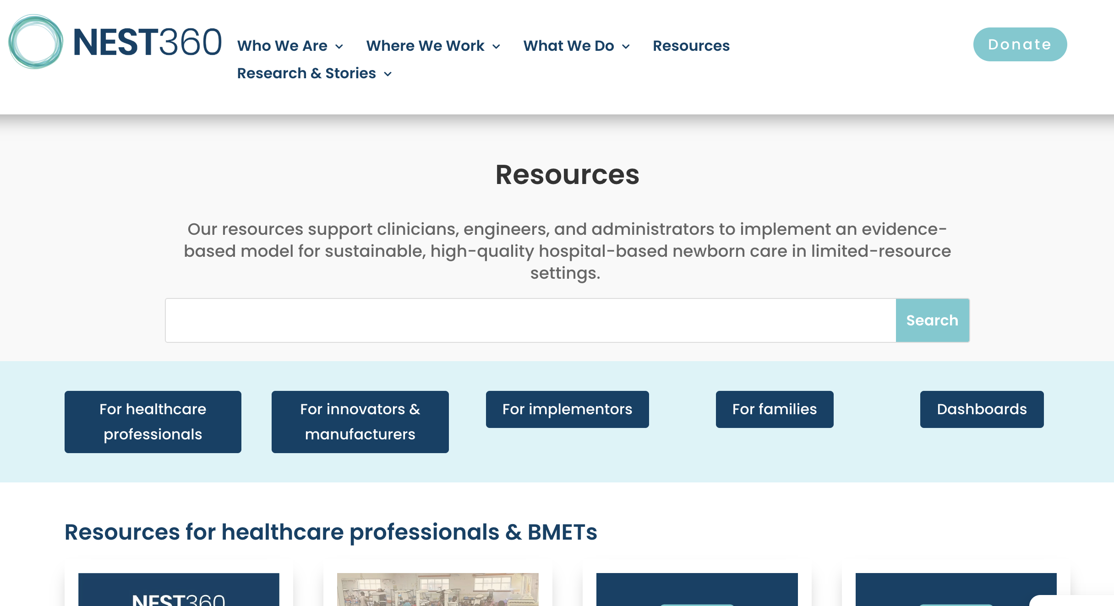



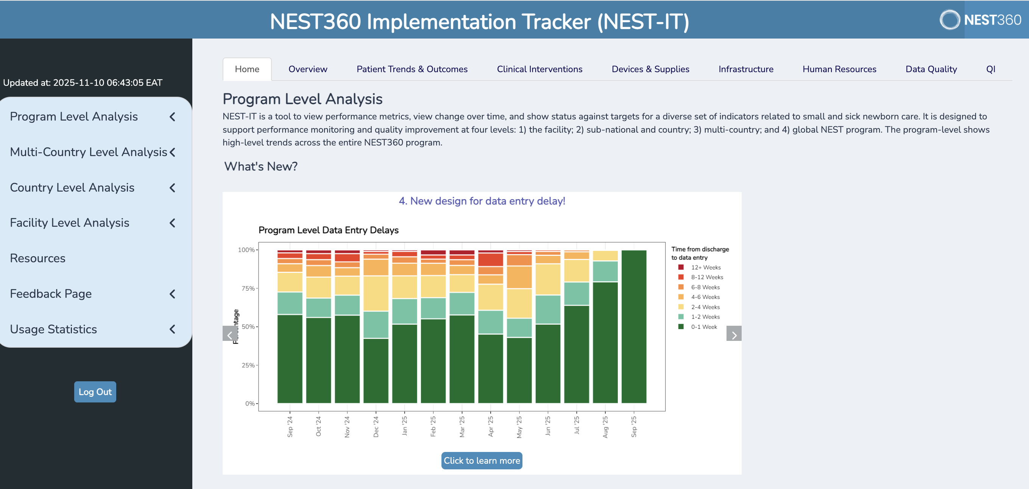
Why are we doing this?
NEST360 Implementation Model

Slide 3
What is an implementation model?
A visual tool that helps us to systematically plan, report, and synthesize how NEST360 implemented small and sick newborn care
The core elements of the model are implementation factors, strategies, mechanisms of action, and outcomes

Slide 4





What are the components of the model?
The barriers and facilitators that influence the success of implementing SSNC in level 2+ neonatal units
The activities NEST used to overcome barriers, leverage facilitators, and implement SSNC in our supported countries
The processes or pathways through which a strategy produces change in outcomes
The indicator used to assess how well an intervention is implemented into practice
Implementation factors
Strategies
Mechanisms of Action
Outcomes
Notes:
Intervention
The "thing" we want to get into our communities (NEST360 model or SSNC Level 2+ care)
For NEST360 this is evidence-based SSNC in level 2+ neonatal units

Slide 5




How is a NEST360 implementation model useful?
Tells the full story of our implementation work
Enhance communication with funders and partners
Supports planning, evaluation, and adaptations
Supports long-term sustainability and scale-up decisions for Phase 2

Slide 6






Data sources to develop the NEST360 implementation model
Pre-existing frameworks
Phase 1 roadmap & theory of change
Program documentation
Routinely collected programmatic data
Publications
Team input
Notes:
Pre-existing frameworks (IRLM, SSNC implementation toolkit)
NEST360 roadmap from phase 1
Program documents (QI documentation)
Routinely collected programmatic data (NID, NEST-IT, context tracker)
Publications
Team input

Slide 7
The NEST360 implementation model is a multi-tiered guide that…
  Describes the implementation environment where NEST360 operates
  Details the strategies and activities used to reduce newborn mortality
  Presents outcomes tracked by NEST360 along with the overall program impact
Reports on NEST360’s work
  Identified key implementation factors to consider during planning
  Connects to existing NEST360 tools and resources that support implementation
  Defines essential processes and impact measures to monitor throughout implementation
Provides a model others can adapt to implement similar efforts

Slide 8
Tiers within the model
Tier 1
Provides a graphic that can be added to grant proposals or shared with funders and stakeholders
Tier 2
Provides general information that other implementers should consider if they’d like to implement a “NEST-like model”
Tier 3
Provides the details one could need to gain a comprehensive understanding of how NEST360 implemented our package
Notes:
This model has 3 tiers with different levels of details
A graphic that can be added to grant proposals or shared with funders and stakeholders
Full detailed version (with links to resources) of the implementation factors NEST encountered, the specific activities that were implemented, the reason why those activities were chosen, and the results that we found

Slide 9




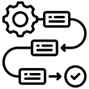




Implementation Factors
NEST360 Implementation Model: Tier 1
Strategies used by NEST360
Mechanisms
Outcomes
Impact
Outcomes
Impact
Intervention: Evidence-based small and sick newborn care in Level 2+ units
Strategies used by NEST360
Mechanisms
Global
Life saving technology
Reduction in newborn mortality!
National/Country
Multi-level sustainable systems change
SSNC core components/ systems components
Education ecosystem
How strategies interact with implementation factors
Data-driven
action
Hospital
Notes:
Colors will carry throughout the model to all tiers

Slide 10
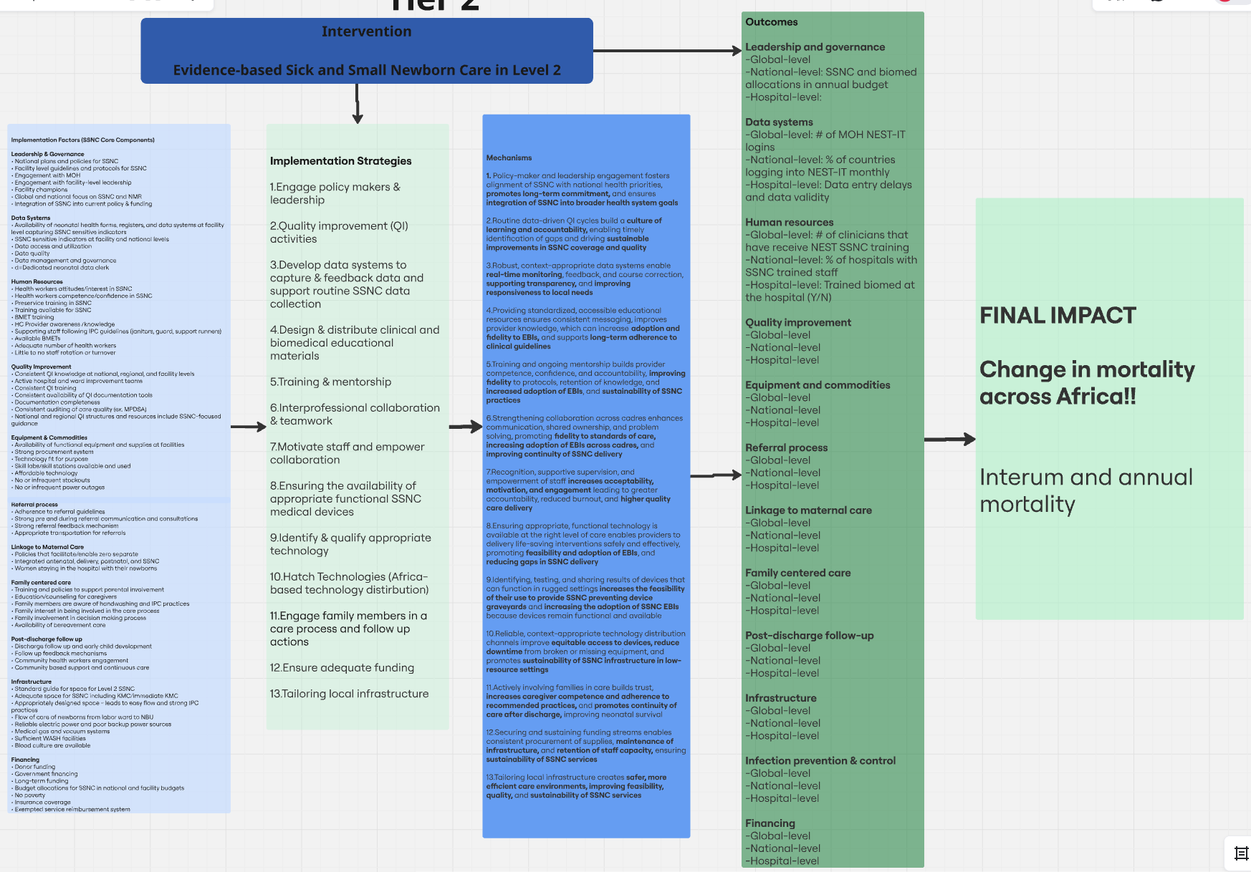
Tier 2
An expanded list of implementing factors organized by SSNC implementing factors
This is where we provide details related to implementing the NEST model, but it remains neutral in stance
Notes:
Provides general information that other implementers should consider if they'd like to implement a "NEST-like model"

Slide 11
Tier 2
Broad categories for implementation strategies
This is where we provide details related to implementing the NEST model, but it remains neutral in stance

Slide 12
Tier 2
A simple explanation for how the strategy group would interact with implementing factors to get the outcome we are looking for
This is where we provide details related to implementing the NEST model, but it remains neutral in stance

Slide 13
Tier 2
Examples of outcomes that NEST measured
Organized by SSNC core components and examples for program, country, and hospital level outcomes
This is where we provide details related to implementing the NEST model, but it remains neutral in stance

Slide 14
Tier 2: Implementation Factors Part 1
Leadership & Governance
  National plans and policies for SSNC
  Facility level guidelines and protocols for SSNC
  Engagement with MOH
  Engagement with facility-level leadership
  Facility champions
  Global and national focus on SSNC and NMR
  Integration of SSNC into current policy & funding
Data Systems
  Availability of neonatal health forms, registers, and data systems at facility level capturing SSNC sensitive indicators
  SSNC sensitive indicators at facility and national levels
  Data access and utilization
  Data quality
  Data management and governance
  Dedicated neonatal data clerk
Human Resources
  Health workers attitudes/interest in SSNC
  Health workers competence/confidence in SSNC
  Preservice training in SSNC
  Training available for SSNC
  BMET training
  HC Provider awareness /knowledge
  Supporting staff following IPC guidelines (janitors, guard, support runners)
  Available BMETs
  Adequate number of health workers
  Little to no staff rotation or turnover
Quality Improvement
  Consistent QI knowledge at national, regional, and facility levels
  Active hospital and ward improvement teams
  Consistent QI training
  Consistent availability of QI documentation tools
  Documentation completeness
  Consistent auditing of care quality (ex. MPDSA)
  National and regional QI structures and resources include SSNC-focused guidance
Equipment & Commodities
  Availability of functional equipment and supplies at facilities
  Strong procurement system
  Technology fit for purpose
  Skill labs/skill stations available and used
  Affordable technology
  No or infrequent stockouts
  No or infrequent power outages
Referral process
  Adherence to referral guidelines
  Strong pre and during referral communication and consultations
  Strong referral feedback mechanism
  Appropriate transportation for referrals

Slide 15
Tier 2: Implementation Factors Part 2
Linkage to Maternal Care
  Policies that facilitate/enable zero separate
  Integrated antenatal, delivery, postnatal, and SSNC
  Women staying in the hospital with their newborns
Family centered care
  Training and policies to support parental involvement
  Education/counseling for caregivers
  Family members are aware of handwashing and IPC practices
  Family interest in being involved in the care process
  Family involvement in decision making process
  Availability of bereavement care
Post-discharge follow up
  Discharge follow up and early child development
  Follow up feedback mechanisms
  Community health workers engagement
  Community based support and continuous care
Infrastructure
  Standard guide for space for Level 2 SSNC
  Adequate space for SSNC including KMC/immediate KMC
  Appropriately designed space - leads to easy flow and strong IPC practices
  Flow of care of newborns from labor ward to NBU
  Reliable electric power and poor backup power sources
  Medical gas and vacuum systems
  Sufficient WASH facilities
  Blood culture are available
Financing
  Donor funding
  Government financing
  Long-term funding
  Budget allocations for SSNC in national and facility budgets
  No poverty
  Insurance coverage
  Exempted service reimbursement system

Slide 16
Tier 2 strategies
Engage policy makers & leadership
Quality improvement (QI) activities
Develop data systems to capture & feedback data and support routine SSNC data collection
Design & distribute clinical and biomedical educational materials
Training & mentorship
Interprofessional collaboration & teamwork
7. Motivate staff and empower
collaboration
8. Ensuring the availability of appropriate
functional SSNC medial devices
9. Identify & qualify appropriate technology
10. Hatch Technologies (African-based
technology distribution)
11. Engage family members in a care
process and follow up actions
12. Ensure adequate funding
13. Tailoring local infrastructure
Notes:
General strategy categories
We provide more details later on

Slide 17
Tier 2: Strategies & Mechanisms Part 1
Colors coordinates to the tier 1 model
Mechanism
Strategies used by NEST360
1. Policy-maker and leadership engagement fosters alignment of SSNC with national health priorities, promotes long-term commitment, and ensures integration of SSNC into broader health system goals
1. Engage policy makers & leadership
2.Routine data-driven QI cycles build a culture of learning and accountability, enabling timely identification of gaps and driving sustainable improvements in SSNC coverage and quality
2. Quality improvement (QI) activities
3.Robust, context-appropriate data systems enable real-time monitoring, feedback, and course correction, supporting transparency, and improving responsiveness to local needs
3. Develop data systems to capture & feedback data and support routine SSNC data collection

Slide 18
Tier 2: Strategies & Mechanisms Part 2
Mechanism
Strategies used by NEST360
4.Providing standardized, accessible educational resources ensures consistent messaging, improves provider knowledge, which can increase adoption and fidelity to EBIs, and supports long-term adherence to clinical guidelines
4. Design & distribute clinical and biomedical educational materials
5.Training and ongoing mentorship builds provider competence, confidence, and accountability, improving fidelity to protocols, retention of knowledge, and increased adoption of EBIs, and sustainability of SSNC practices
5. Training & mentorship
6.Strengthening collaboration across cadres enhances communication, shared ownership, and problem solving, promoting fidelity to standards of care, increasing adoption of EBIs across cadres, and improving continuity of SSNC delivery
6. Interprofessional collaboration & teamwork

Slide 19
Tier 2: Strategies and Mechanisms Part 3
Mechanism
Strategies used by NEST360
7.Recognition, supportive supervision, and empowerment of staff increases acceptability, motivation, and engagement leading to greater accountability, reduced burnout, and higher quality care delivery
7. Motivate staff and empower collaboration
8.Ensuring appropriate, functional technology is available at the right level of care enables providers to delivery life-saving interventions safely and effectively, promoting feasibility and adoption of EBIs, and reducing gaps in SSNC delivery
8. Ensuring the availability of appropriate functional SSNC medical devices
9.Identifying, testing, and sharing results of devices that can function in rugged settings increases the feasibility of their use to provide SSNC preventing device graveyards and increasing the adoption of SSNC EBIs because devices remain functional and available
9. Identify & qualify appropriate technology

Slide 20
Tier 2: Strategies and Mechanisms Part 4
Mechanism
Strategies used by NEST360
10.Reliable, context-appropriate technology distribution channels improve equitable access to devices, reduce downtime from broken or missing equipment, and promotes sustainability of SSNC infrastructure in low-resource settings
10. Hatch Technologies (Africa-based technology distribution)
11.Actively involving families in care builds trust, increases caregiver competence and adherence to recommended practices, and promotes continuity of care after discharge, improving neonatal survival
11. Engage family members in a care process and follow up actions
12.Securing and sustaining funding streams enables consistent procurement of supplies, maintenance of infrastructure, and retention of staff capacity, ensuring sustainability of SSNC services
12. Ensure adequate funding
13.Tailoring local infrastructure creates safer, more efficient care environments, improving feasibility, quality, and sustainability of SSNC services
13. Tailoring local infrastructure

Slide 21
Tier 2: Outcomes
Leadership and governance (examples)
  National-level: SSNC and biomed allocations in annual budget
  Hospital-level:
Data systems (examples)
  Global-level: # of MOH NEST-IT logins
  National-level: % of countries logging into NEST-IT monthly
  Hospital-level: Data entry delays and data validity
Human resources (examples)
  Global-level: # of clinicians that have receive NEST SSNC training
  National-level: % of hospitals with SSNC trained staff
  Hospital-level: Trained biomed at the hospital (Y/N)
Linkage to maternal care
  Global-level
  National-level
  Hospital-level
Family centered care
  Global-level
  National-level
  Hospital-level
Post-discharge follow-up
  Global-level
  National-level
  Hospital-level
Quality improvement
  Global-level
  National-level
  Hospital-level
Equipment and commodities
  Global-level
  National-level
  Hospital-level
Referral process
  Global-level
  National-level
  Hospital-level
Infrastructure
  Global-level
  National-level
  Hospital-level
Financing
  Global-level
  National-level
  Hospital-level
Impact
  Coverage rates
  Mortality change

Slide 22
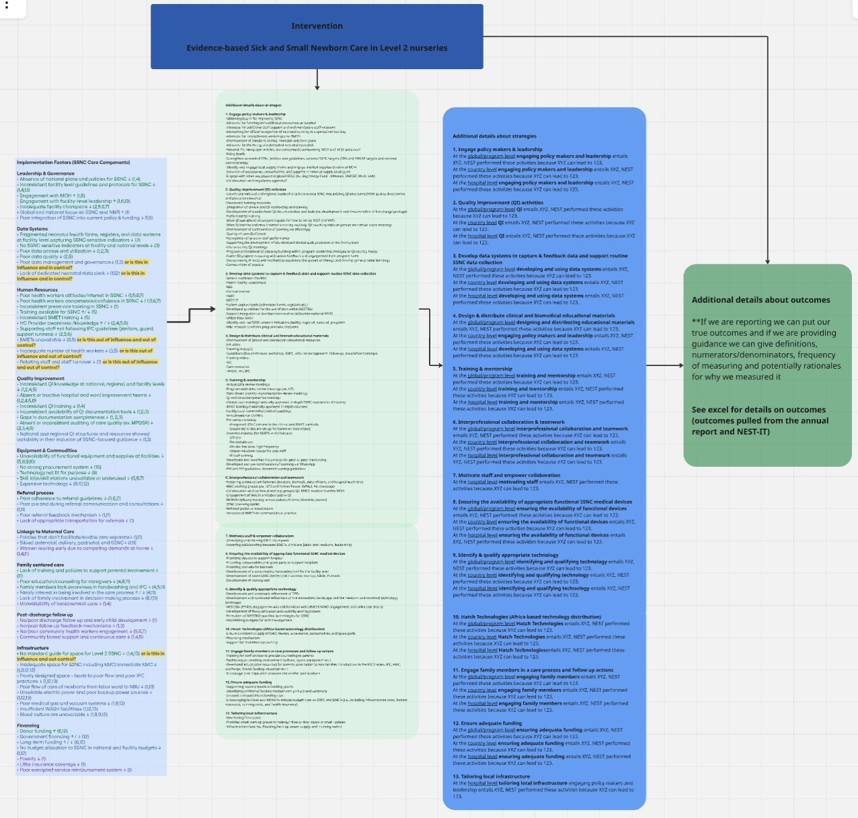
Tier 3
Implementation factors are labeled as a barrier or facilitator based on NEST’s experience, linked to strategies, and we explore the level of control we had over each factor
This is where we report what NEST did and give practical resources for what others can do
Notes:
Full detailed version (with links to resources) of the implementation factors NEST encountered, the specific activities that were implemented, the reason why those activities were chosen, and the results that we found
This tier provides all the details that one could need to gain a comprehensive understanding of how NEST360 implemented our package

Slide 23
Tier 3
This is where we report what NEST did and give practical resources for what others can do
Discrete implementation strategies are listed under the general group of strategies

Slide 24
Tier 3
This is where we report what NEST did and give practical resources for what others can do
Each strategy group has a description for how those activities impacted the global, country, and hospital level

Slide 25
TIER 3 GRAPHIC
This is where we report what NEST did and give practical resources for what others can do
We provide a detailed explanation of the outcomes that NEST360 tracked including numerator, denominator, definition, and frequency of measurement

Slide 26
Tier 3: Implementation Factors Part 1
Data Systems
  Fragmented neonatal health forms, registers, and data systems at facility level capturing SSNC sensitive indicators ↓ (3)
  No SSNC sensitive indicators at facility and national levels ↓ (3)
  Poor data access and utilization ↓ (1,2,3)
  Poor data quality ↓ (2,5)
  Poor data management and governance↓ (1,3) or is this in influence and in control?
  Lack of dedicated neonatal data clerk ↓ (1,12) or is this in influence and in control?
Human Resources
  Poor health workers attitudes/interest in SSNC ↓ (1,5,6,7)
  Poor health workers competence/confidence in SSNC ↓ ( 1,5,6,7)
  Inconsistent preservice training in SSNC ↓ (1)
  Training available for SSNC ↑/ ↓ (5)
  Inconsistent BMET training ↓ (5)
  HC Provider awareness /knowledge ↑ / ↓ (2,4,5,6)
  Supporting staff not following IPC guidelines (janitors, guard, support runners) ↓ (2,5,6)
  BMETs unavailable ↓ (3,5)
  Inadequate number of health workers ↓ (3,5) or is this out of influence and out of control?
  Rotating staff and staff turnover ↓ (1) or is this out of influence and out of control?
Up arrow- Facilitator
Down arrow- Barrier
Number- Corresponds to a group of strategies
Green- In sphere of influence & control
Blue- In sphere of influence, outside sphere of control
Purple- Outside sphere of influence & control
Notes:
Leadership & Governance
Absence of national plans and policies for SSNC ↓ (1,4)
Inconsistent facility level guidelines and protocols for SSNC ↓ (1,4,13)
Engagement with MOH ↑ (1,6)
Engagement with facility-level leadership ↑ (1,6,13)
Inadequate facility champions ↓ (2,5,6,7)
Global and national focus on SSNC and NMR ↑ (1)
Poor integration of SSNC into current policy & funding ↓ (1,6)

Slide 27
Tier 3: Implementation Factors Part 2
Quality Improvement
  Inconsistent QI knowledge at national, regional, and facility levels ↓ (1,2,4,5)
  Absent or inactive hospital and ward improvement teams ↓ (1,2,4,5,6)
  Inconsistent QI training ↓ (1,4)
  Inconsistent availability of QI documentation tools ↓ (1,2,3)
  Gaps in documentation completeness ↓ (1, 2,3)
  Absent or inconsistent auditing of care quality (ex. MPDSA) ↓ (2,3,4,5)
  National and regional QI structures and resources showed variability in their inclusion of SSNC-focused guidance ↓ (1,3)
Equipment & Commodities
  Unavailability of functional equipment and supplies at facilities ↓ (5,8,9,10)
  No strong procurement system ↓ (10)
  Technology not fit for purpose ↓ (9)
  Skill labs/skill stations unavailable or underused ↓ (5,6,7)
  Expensive technology ↓ (8,10,12)
Referral process
  Poor adherence to referral guidelines ↓ (5,6,2)
  Poor pre and during referral communication and consultations ↓ (1,11)
  Poor referral feedback mechanism ↓ (1,11)
  Lack of appropriate transportation for referrals ↓ (1)
Linkage to Maternal Care
  Policies that don’t facilitate/enable zero separate↓ (1,11)
  Siloed antenatal, delivery, postnatal, and SSNC↓ (1,11)
  Women leaving early due to competing demands at home ↓ (1,4,11)
Family centered care
  Lack of training and policies to support parental involvement ↓ (11)
  Poor education/counseling for caregivers ↓ (4,6,11)
  Family members lack awareness in handwashing and IPC ↓ (4,5,11)
  Family interest in being involved in the care process ↑ / ↓ (4,11)
  Lack of family involvement in decision making process ↓ (6,7,11)
  Unavailability of bereavement care ↓ (1,4)
Post-discharge follow up
  No/poor discharge follow up and early child development ↓ (1)
  No/poor follow up feedback mechanisms ↓ (1,3)
  No/poor community health workers engagement ↓ (5,6,7)
  Community based support and continuous care ↓ (1,4,11)

Slide 28
Tier 3: Implementation Factors Part 3
Infrastructure
  No standard guide for space for Level 2 SSNC ↓ (1,4,13) or is this in influence and out control?
  Inadequate space for SSNC including KMC/immediate KMC ↓ (1,3,12,13)
  Poorly designed space - leads to poor flow and poor IPC practices ↓ (1,12,13)
  Poor flow of care of newborns from labor ward to NBU ↓ (1,13)
  Unreliable electric power and poor backup power sources ↓ (1,12,13)
  Poor medical gas and vacuum systems ↓ (1,8,13)
  Insufficient WASH facilities↓ (1,12,13)
  Blood culture are unavailable ↓ (1,8,9,12)
Financing
  Donor funding ↑ (6,12)
  Government financing ↑ / ↓ (12)
  Long-term funding ↑ / ↓ (6,12)
  No budget allocation to SSNC in national and facility budgets ↓ (1,12)
  Poverty ↓ (1)
  Little insurance coverage ↓ (1)
  Poor exempted service reimbursement system ↓ (1)

Slide 29

Implementation factors requests (See poster)
Do we need to add any implementation factors?
Do we need to remove any implementation factors?
Do we need to modify any implementation factors?
Do you agree with the barrier & facilitator labels for the implementation factors?
Do you agree with the implementation factor color coding?
Provide your feedback on level of influence & control with this google survey
Feel free to add a post-it note to the poster with your answer(s)

Slide 30
Tier 3 strategies & mechanisms
Strategies
Mechanisms
Engage policy makers & leadership
QI activities
Develop data systems to capture & feedback data and support routine SSNC fata collection
Design & distribute clinical& biomedical educational materials
Training & mentorship
Interprofessional collaboration & teamwork
Motivate staff & empower collaboration
Ensuring the availability of appropriate functional SSNC medical devices
Identify & qualify appropriate technology
Hatch technologies
Engage family members in care process and follow up actions
Ensure adequate funding
Tailoring local infrastructure
At the global/program level [strategy] entails XYZ, NEST performed these activities because XYZ can lead to 123.
At the country level [strategy] entails XYZ, NEST performed these activities because XYZ can lead to 123.
At the hospital level [strategy] entails XYZ, NEST performed these activities because XYZ can lead to 123.

Slide 31
Strategy requests (See poster)
Do we need to add any new strategies?
Do we need to remove any strategies?
Do we need to modify any strategies?
What NEST resources should we link at this level?
Feel free to add a post-it note to the poster with your answer(s)

Slide 32
Tier 3: Outcomes
Currently living in an excel sheet
Outcomes from FCC report and NEST-IT
Information included
  Domain
  Outcome
  Definition
  Rationale
  Frequency of measurement
  Numerator & denominator
    Global level
    Country level
    Facility level

Slide 33
Walk through example
Contextual factors before
NEST360
Mechanism of action & outcomes
Strategy
Developing and maintaining platforms to visualize relevant SSNC and facility data enables routine data use which enhances SSNC and QI feasibility, quality, and sustainability
Gaps in documentation
Poor data quality
Poor data use
Lack of systems capturing SSNC relevant indicators
Develop data systems to capture and feedback data (e.g., NEST-IT, NID, Hadli)
Links to SSNC Toolkit
Link to NEST resources, country testimonies
Link to outcomes guide
Notes:
Developing and maintaining platforms to visualize SSNC outcomes and facility data fosters routine data use, enhances SSNC and QI feasibility, and support SSNC sustainability
Link to outcomes guide: Presents numerators, denominators, frequency, rationale

Slide 34
Walk through example
Contextual factors before
NEST360
Strategy
Mechanism of action & implementation outcomes
Health workers unavailable
BMETs unavailable
Inconsistent training of health workers and BMETs
Poor data use and quality
Training & mentorship, development & distribution of educational materials
Ongoing training, supervision, and access to standardized materials, build provider competence, confidence, and accountability, improving fidelity, adoption, and sustainability of SSNC delivery
Links to SSNC Toolkit
Link to NEST resources, country testimonies
Presents numerators, denominators, frequency, rationale

Slide 35
Questions?

